Slide 1
Gaussian filter
Mohammed Kifah Jomaa
Mohammed Qasim Kareem

Slide 2
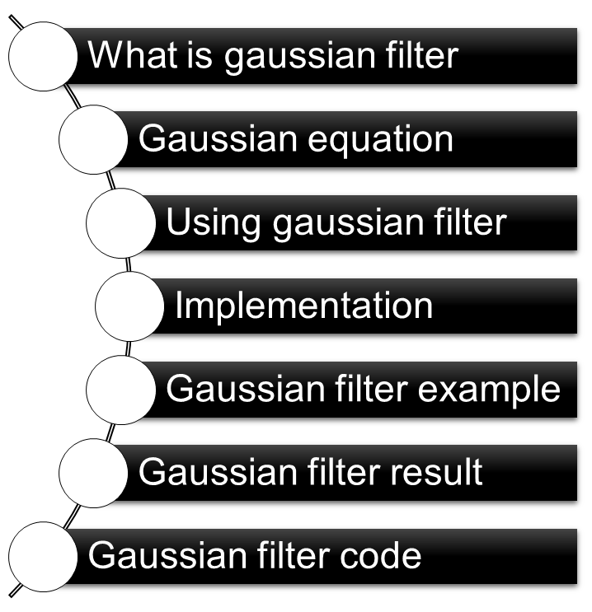
Presentation Outline

Slide 3
What is Gaussian filter
A Gaussian filter is a linear filter .
It's usually used to blur the image or to reduce noise .
The Gaussian filter alone will blur edges and reduce contrast .

Slide 4
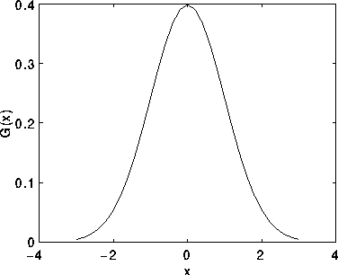

Gaussian equation
The Gaussian distribution in 1-D has the form:
Where σ is the standard
deviation of the distribution.
Figure 1 1-D Gaussian distribution with mean 0 and σ =1

Slide 5
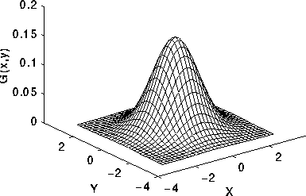

Gaussian equation
In images we have 2-D arrays so we need
2-D Gaussian equation
Figure 2 2-D Gaussian distribution with mean (0,0) and σ =1

Slide 6
Using Gaussian filter
The idea of Gaussian filter to use 2-D distribution as a `point-spread' function and this is achieved by convolution.
the Gaussian distribution is non-zero everywhere

Slide 7
Implementation
Design the kernel .
Consider a local region from an image .
Convolve the kernel and the local region .
The centered value of the local region replaced by the resulted value

Slide 8
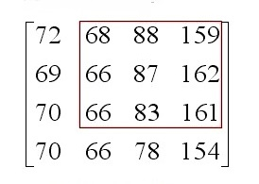
Gaussian filter example
Suppose we have the following image
The local region is the red bordered .

Slide 9
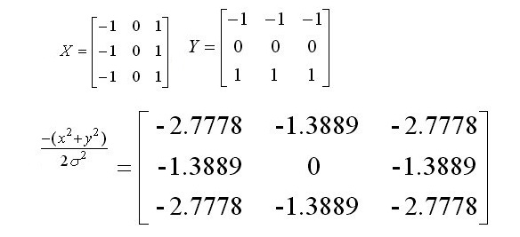
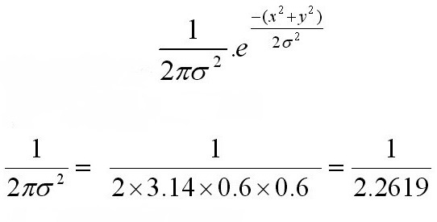
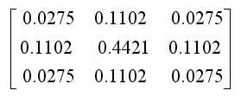
Gaussian filter example
Lets assume the segma = 0.6 and the kernel size = 3*3 and the width of it x=3 and height y = 3 .
The new kernel =

Slide 10
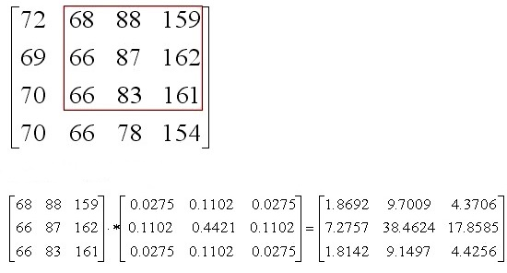
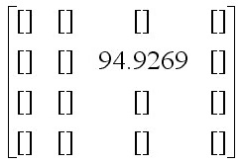
Gaussian filter example

Slide 11
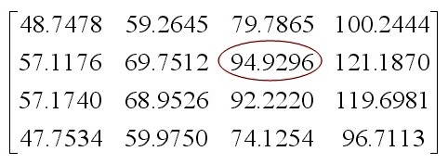
Gaussian filter example
Repeat the operation on all parts of the region and the final result of gaussian filter is

Slide 12
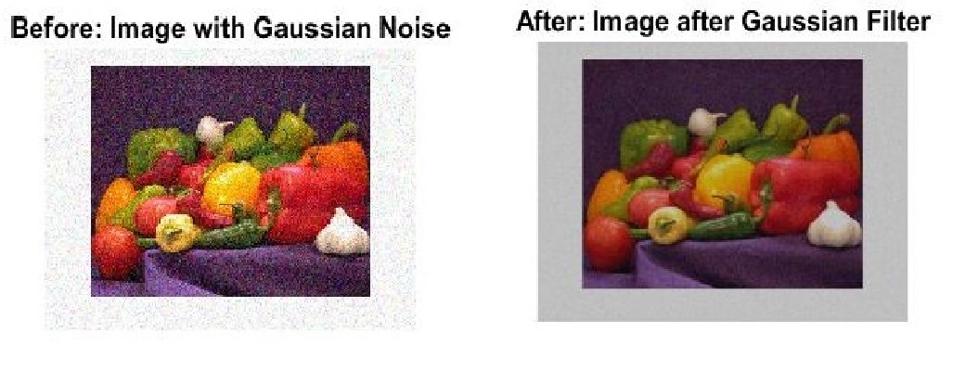
Gaussian filter result

Slide 13
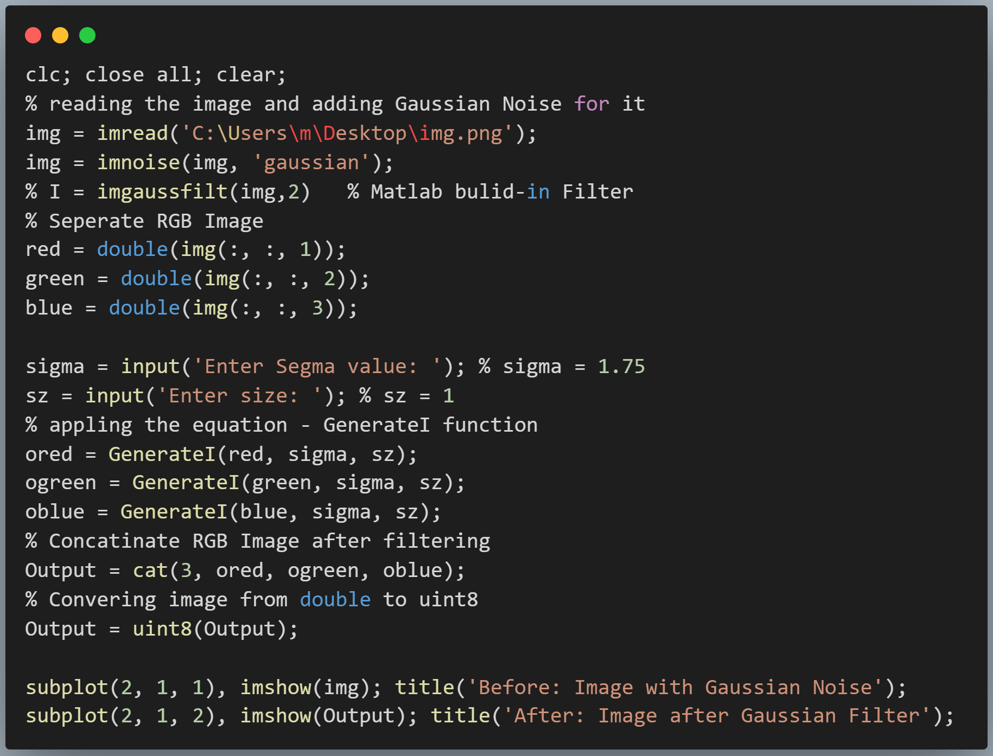
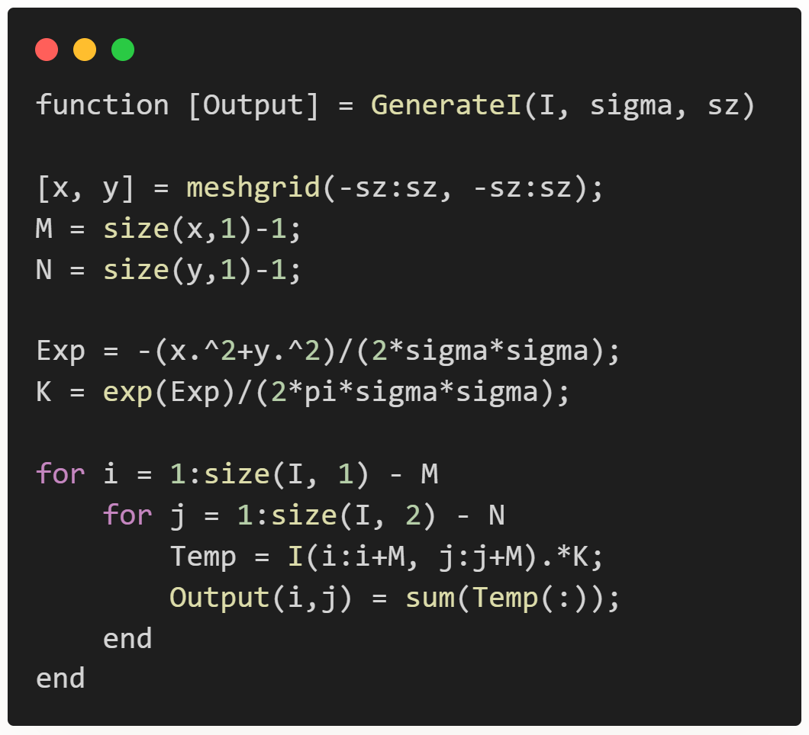
Gaussian filter code
Function

Slide 14


